Slide 1
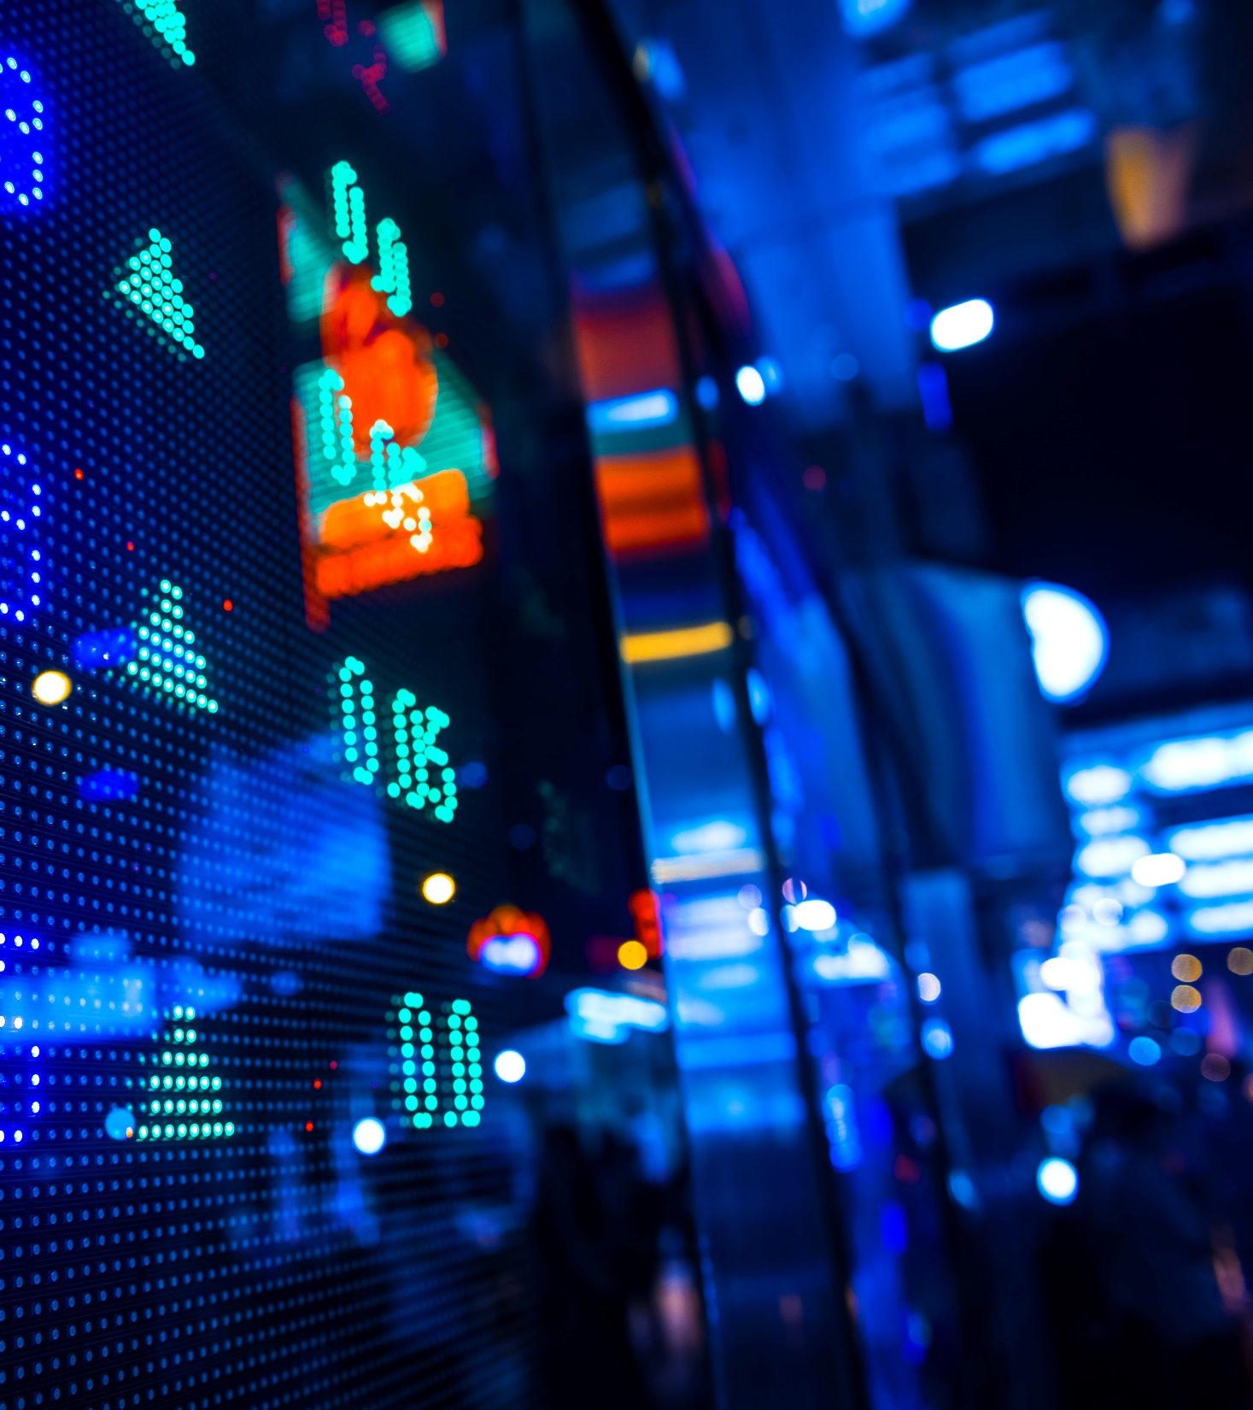
Investing for the Future
Why the vast majority are doing it wrong.
Max Miorada

Slide 2
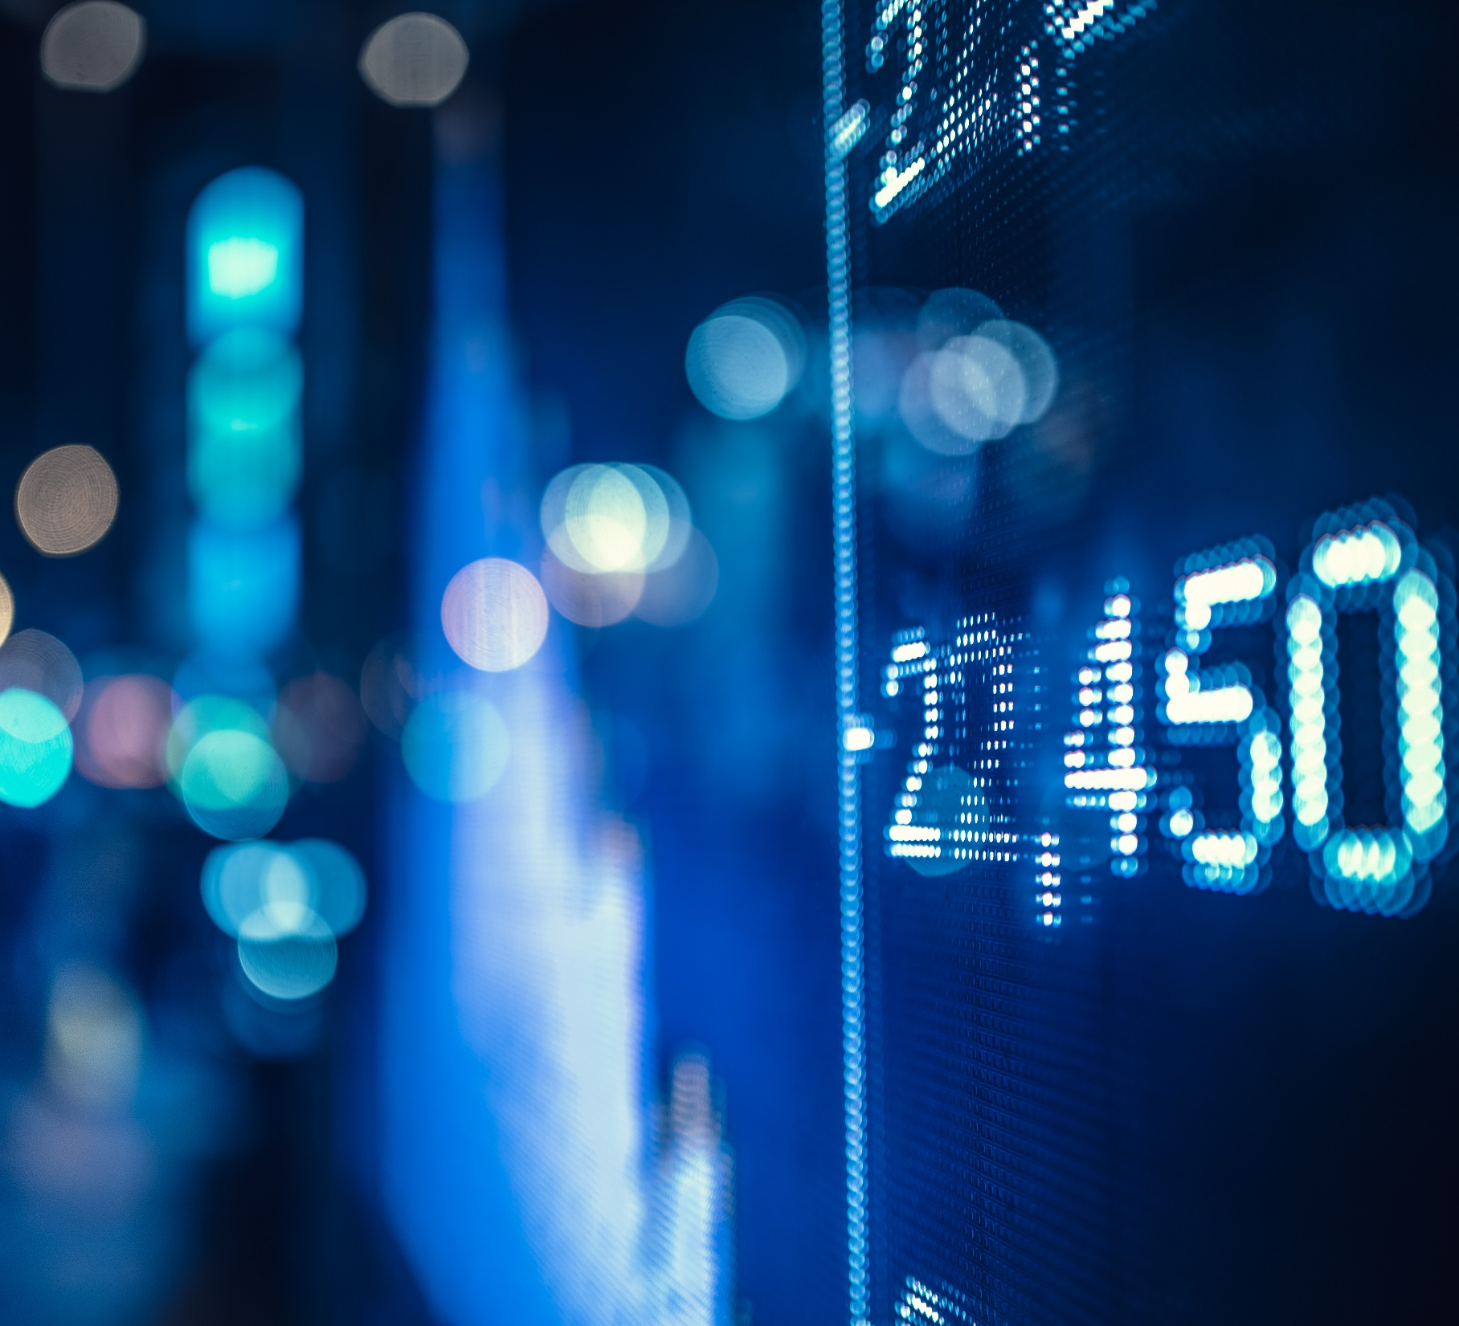
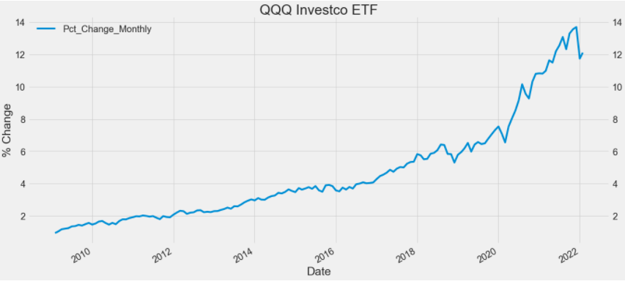
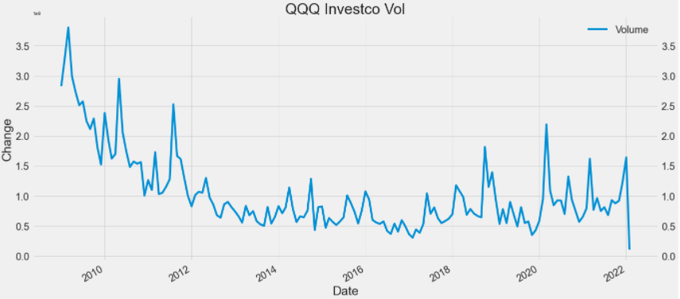
GLobal Unrest
Why does everything feel like the world is falling apart since 2009?
Covid
Civil Unrest
Political Instability
Global Warming
Nations Divided
Wealth divide
China’s Trade War Assertion
Talks of Nuclear Weapons

Slide 3
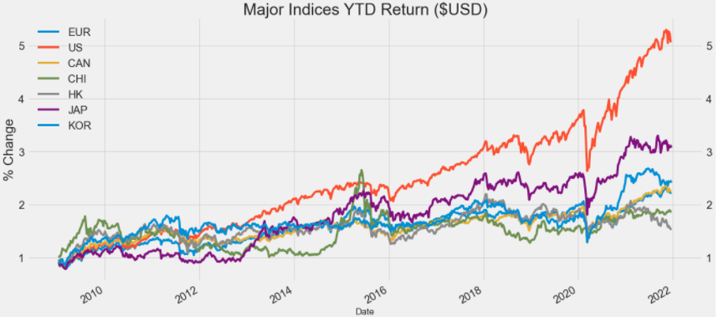
Index Returns
How the Major Index’s have Recovered.
USA : Russell 3000 + 507%
JAP : Nikkei 225 + 324%
KOR : Kospi + 243%
CAN : S&P | TSX + 225%
EUR : Stoxx + 222%
CHI : SSE + 186%
HK : Hang Seng + 154%

Slide 4
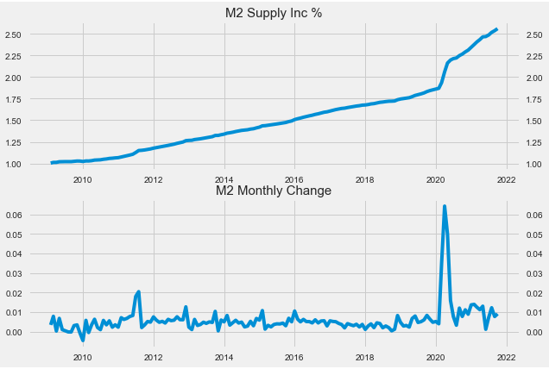
The Cause
Money Supply Debasement
(M2)
What
Increase: 250% since 2009
$ USD

Slide 5
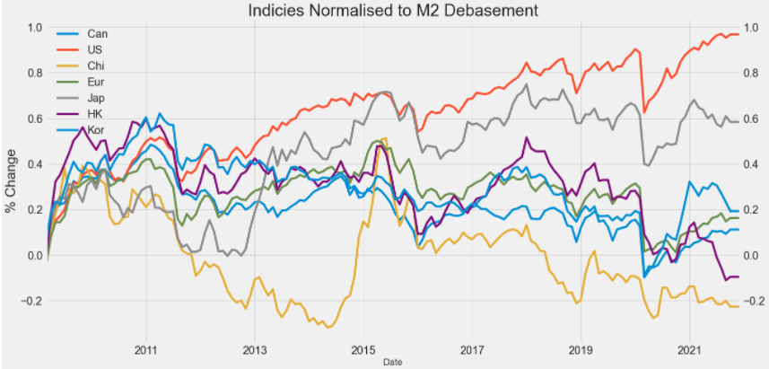
Returns Normalized
How the Major Index’s have Recovered
USA : Russell 3000 | + 96%
JAP : Nikkei 225 | + 58%
KOR : Kospi | + 19%
EUR : Stoxx | + 16%
CAN : S&P | TSX | + 11%
HK : Hang Seng | -9%
CHI : SSE | -22%

Slide 6
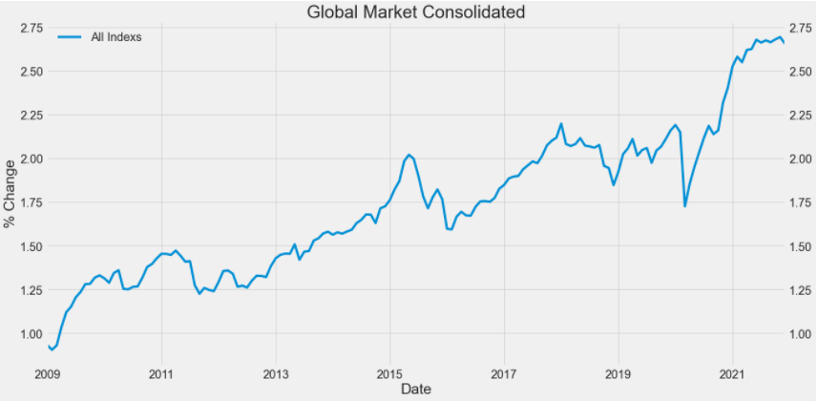
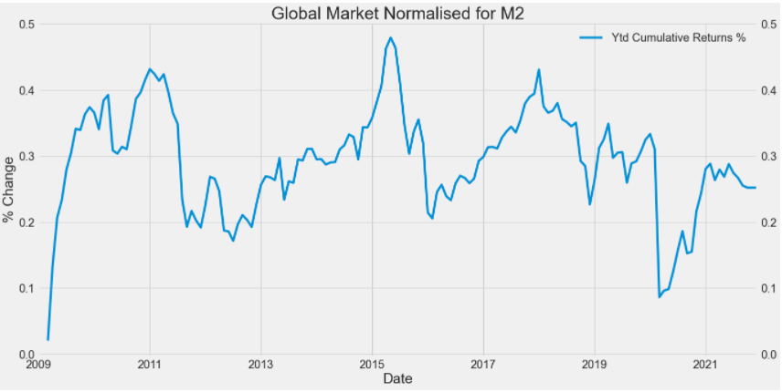
Global MArket
Global Market | + 270%
Global Market Normalized | + 25%

Slide 7
The Problem?
Households loosing purchasing power daily, unknowingly.
Investors making small returns to barely cover money supply debasement.
How?
Mis management of Government funds and Countries currencies
International Monetary Fund
Federal Reserves.

Slide 8

The Solution?
To Inflationary Fiat :
Bitcoin
To Low Real Returns In Markets:
Crypto

Slide 9
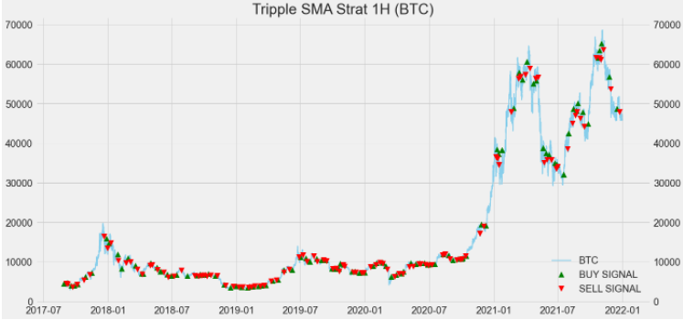
Trading Strategy
Basic Strategy to beat Buy & Hold.
+ 1209% since late 2017
Tested:
Macd (moving average convergence divergence)
Double Ema & RSI
On Balance Volume
Triple SMA (15,50,200)

Slide 10
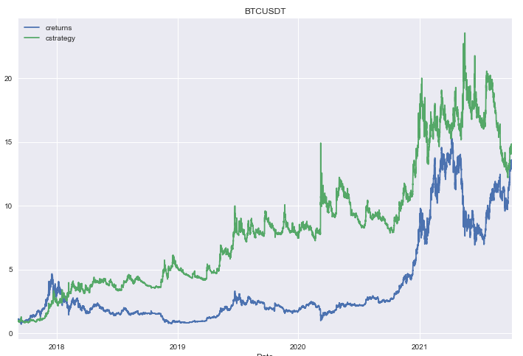
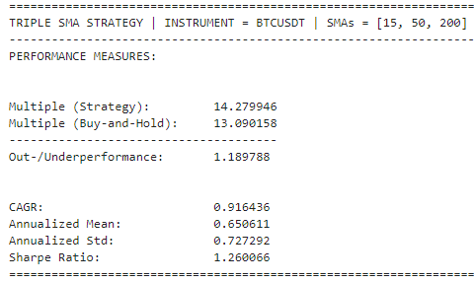
Results
Long – Short Backtester Class.
Get data
Prepare data
Run backtest
Plot results
Print performance
Buy and hold : 1209%
Strategy : 1327%

Slide 11
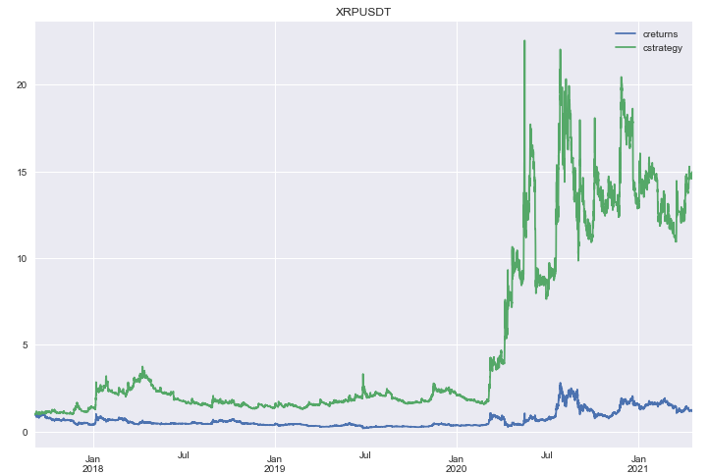
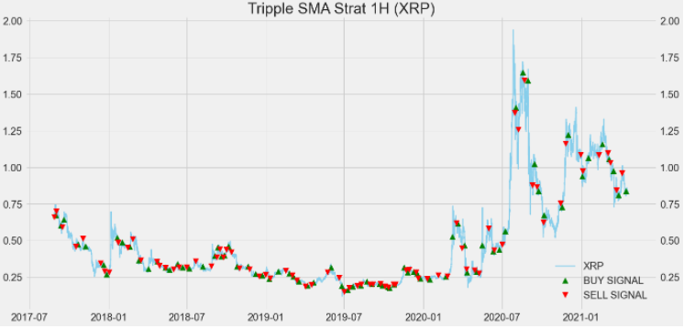
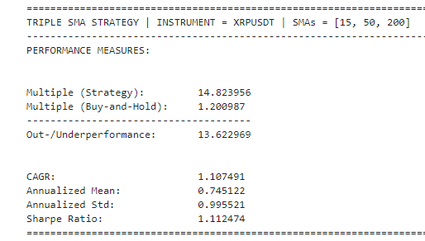
XRP
Testing With other Assets.
Buy and hold : 20%
Strategy : 1382%

Slide 12
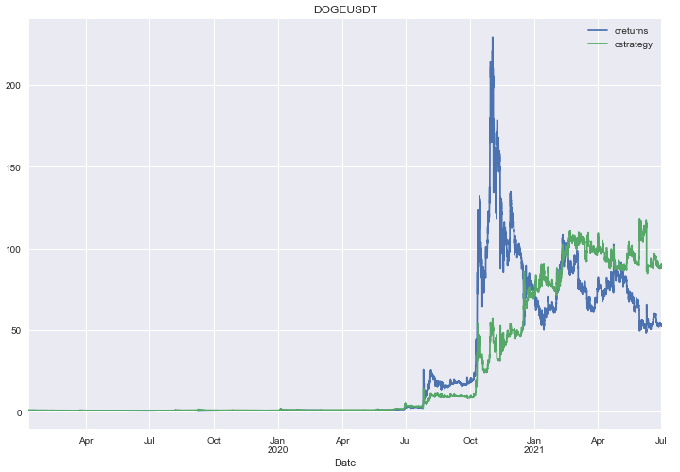
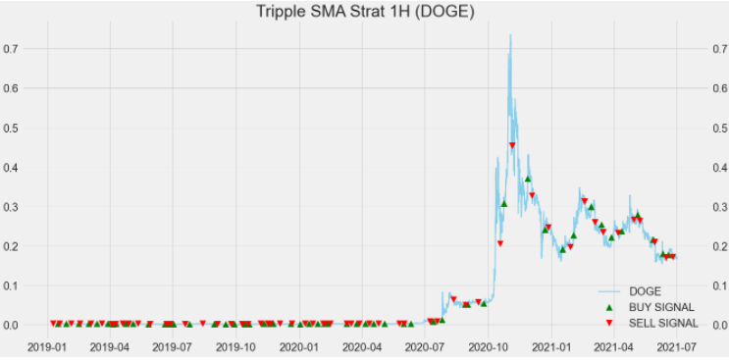
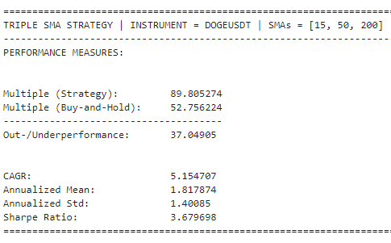
Doge
Testing With Volatile Assets
Buy and hold : 5275%
Strategy : 8980%

Slide 13

Problems encountered
Over fitting the data
Back testing correctly
Time management
Was hoping to implement the strategy for paper trading.

Slide 14
Conclusion
Not many Assets can outpace m2 debasement, as it gets worse every year substantially.
The more problems the economy encounters the worse it gets.
Each $ printed by the federal reserves takes away purchasing power of the everyday person.
The most effective hedge so far is Cryptocurrency market.

Slide 15
Questions?

